Slide 1
Exporting from Canada: Legal Considerations
Trade Accelerator Program
Legal Session
Presented to
Calgary Economic Development
September 10, 2019
Presenters
Noren Howg, Lawyer, Intellectual Property
George Reid, Lawyer, International Trade & Investment

Slide 2
Commercial Considerations

Slide 3
Commercial and Contractual Considerations
Evaluation Stage (i.e., where to start?)
Structuring Considerations
Is there a need for a local presence?
Foreign entity owned by Canadian parent
Local joint-venture partner
Local distributor (exclusive or non-exclusive)
If not, then …
Direct sales/Exports

Slide 4
Commercial and Contractual Considerations
Do your due diligence!
Credit-worthiness
How are you getting paid (wire, Letter of credit, payment terms, etc.)?
Anti-corruption and economic sanctions risk
Are you selling to a foreign government or an entity that receives public funding?

Slide 5
Commercial and Contractual Considerations
2) Agreement Stage
Written Agreement
Informal written agreement (e.g. Term Sheet)
Formal written Agreement (e.g. Supply Agreements, Distribution Agreements, Service Agreements, Purchase Orders and License Agreements)

Slide 6
Commercial and Contractual Considerations
3) Select Key Terms
Boilerplate Agreements
Governing Law
Incoterms
Dispute Resolution (Arbitration)
“Local Law” Risks
Insurance

Slide 7
Customs & Trade Considerations

Slide 8
Exporting goods/services – what you need to know
The international framework for import/export rules
Getting your product out of the country and into another country
Be aware of export sanctions, export controls and anti-corruption risks

Slide 9
International framework for import/export rules
Customs Duties on imported goods
Determined by the tariff classification, value and origin of the goods
Tariff Classification: Harmonized to 6-digits for all World Customs Organization members.
Canadian Customs Tariff: https://www.cbsa-asfc.gc.ca/trade-commerce/tariff-tarif/2018/menu-eng.html
Value – usually the price paid or payable for the goods
Origin – determined by reference to specific rules.
If claiming the basic Most Favoured Nation, not complicated.
If claiming duty-free or reduced duties based on a free trade agreement, can be complicated.

Slide 10
International framework for import/export rules
Don’t forget the GST on imports!
Most countries have some form of value-added tax on imports
Rules can be very complicated, depending on the transaction structure

Slide 11
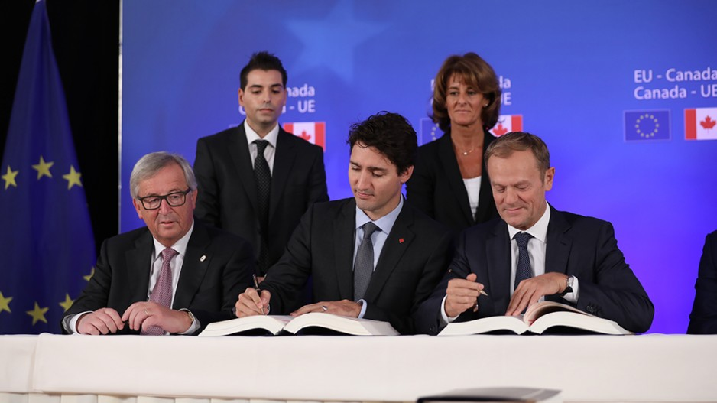
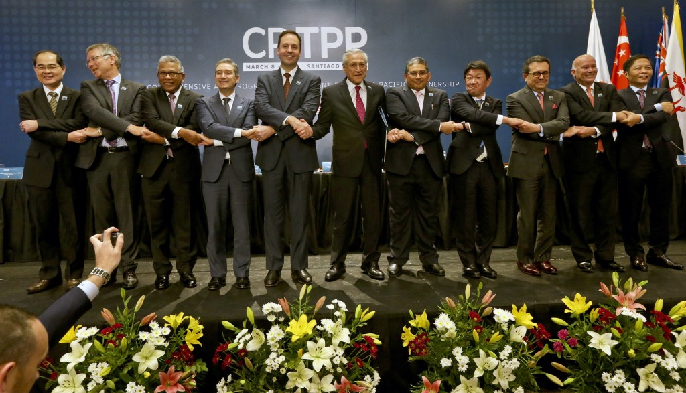
What Are FTAs?
Each FTA is different
Common elements:
Tariff reduction
Customs facilitation
Regulatory harmonization
Market access via quotas
Dispute resolution
Must know and understand “rule of origin” for each product exported
“Certificate of Origin”—a legally binding document, akin to an affidavit

Slide 12
International framework for import/export rules
Exporting
Usually limited to reporting the export of the goods
Big exception for the U.S. – no export reporting required unless the good is controlled by a Federal statute, in which case, export reporting is necessary
Service providers exporting controlled technology must also obtain a permit for, and export report, a transfer of controlled technology

Slide 13
Getting your product our of the country
Know your product
HS tariff classification
How is the product regulated at the provincial and Federal level?
Are special permits required to import/export?
For example, Export Controls apply to goods and technology that have dual military and civilian uses (lasers, encryption), or other goods the Government of Canada decides to control as a matter of policy
Even sending or allowing access to controlled software may require a permit!

Slide 14
Getting your product into another country
Goods: How is your product regulated in your customer’s country and what permits does your customer need to import it?
Agri-food products typically have stringent requirements
Depending on the market, there may be restrictions that have no equivalent in Canada
Dealing with importer requests: quality certifications, country of origin certifications, certificate of free sale, etc.
Services: Are there business visa requirements? Local tax implications of onboarding a customer located in another country?

Slide 15
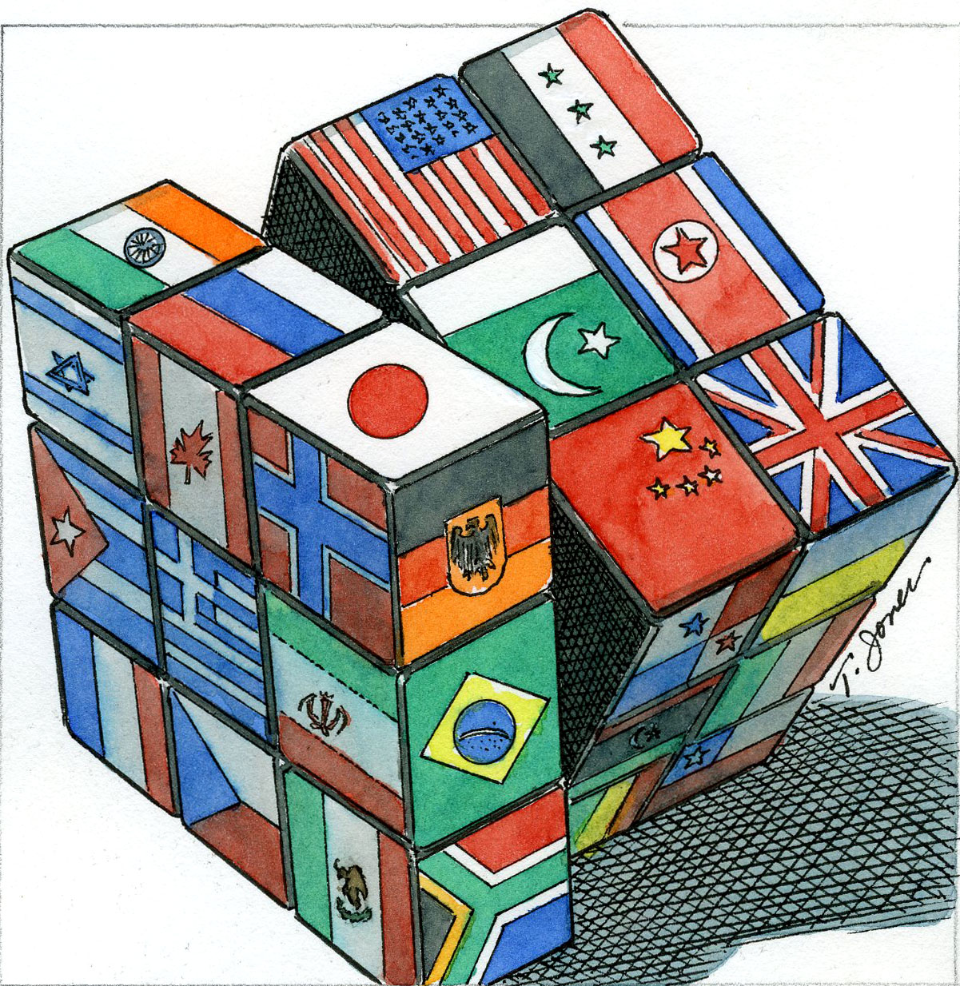
Special considerations: Economic Sanctions
Canada restricts dealing with certain countries & people
Special Economic Measures Act
United Nations Act (U.N. Security Council)
Criminal Code (terrorist groups)
Freezing Assets of Corrupt Foreign Officials Act
Justice for Victims of Corrupt Foreign Officials Act
Blocking orders (Cuba)
Beware: measures change frequently and changes are immediate
Permits can be obtained on a case by case basis
Non-compliance has serious consequences: seizure of goods, potential criminal prosecution, harm to reputation

Slide 16
Special Considerations: Corruption & Bribery
Giving (or offering, or agreeing to give) a bribe—directly or indirectly—is a criminal offence in Canada
Corruption of Foreign Public Officials Act
Criminal Code
Canada has jurisdiction to prosecute if there is a “real and substantial connection” to Canada OR the accused is a Canadian company or Canadian individual
No “facilitation payment” exception in Canada (since October 31, 2017)
Consider geography (high risk countries) and subject matter (e.g., points of contact with government officials)
Consider LEGAL RISK vs. REPUTATIONAL RISK

Slide 17
Special Considerations: Export Controls
Exports are controlled (require permits to export) on the basis of four criteria:
Product Classification
What is being exported?
Is it dual-use, military, nuclear, U.S. origin or some other controlled category?
Destination
Where is the product going?
Is it being trans-shipped or re-exported from the destination?
Is the destination (intermediate or final) subject to sanctions?
End-User
Who is receiving the product? Are they on a restricted list?
End-Use
What will the end-user do with the product?

Slide 18
Intellectual Property refers to a bundle of rights that enables you to preclude others from using the protected aspect of your business without your permission.

Slide 19
Bundle of rights
Patent Act
Trademarks Act
Copyright Act
Confidential Information

Slide 20
Intellectual Property Considerations
Registration of rights:
Product protection strategy – Patents
Brand protection strategy – Trademarks

Slide 21
Noren Howg
Lawyer, Intellectual Property
403.298.3688
howgn@bennettjones.com
George Reid
Lawyer, International Trade & Investment
416.777.7458
reidg@bennettjones.com
Thank You

